Slide 1
Analytics of heart attack patients in MIMIC III database
By
Sritama Paul
AI 395T | AI In Healthcare
University of Texas at Austin
Spring 2026

Slide 2
Overview
This study provides an overview of patients hospitalized with Acute Myocardial Infarction (AMI)(ICD-9 code 410.xx) which is commonly known as heart attack.
We first define the AMI cohort and describe key demographics such as age and gender at first admission.
Then the queries examine healthcare utilization patterns, including insurance distribution, hospital length of stay, and ICU utilization across age groups.
The results reveal that AMI patients were predominantly older adults, with Medicare as the primary insurance provider. Almost all patients required ICU-level care.
Finally, we explore treatment patterns and outcomes through commonly prescribed medications, frequently ordered lab tests, in-hospital mortality, and 30-day readmission metrics.
Together, these queries provide a structured, end-to-end view of AMI hospitalizations, linking patient characteristics, treatment patterns, resource use, and indicate the effectiveness of the care provided through readmission statistics.

Slide 3
Queries
01 | Define AMI Cohort
02 | Average Age at First Admission
03 | Insurance Distribution
04 | Length of Stay (LOS) Statistics
05 | ICU Utilization By Age Group
06 | In-Hospital Mortality
07 | Top Cardiac Medications
08 | Top 10 Most Frequently Ordered Lab Tests
09 | Patient Level Readmission Data
10 | Overall 30-Day Readmission Rate

Slide 4
01. Define AMI Cohort
Data used : admissions, diagnoses_icd
Description and interpretation
The query identifies all hospital admissions where the diagnosis code starts with 410%, corresponding to Acute Myocardial Infarction (AMI). It returns unique patient IDs and hospital admission IDs.
This defines the study cohort — all hospital stays in which a heart attack (AMI) was diagnosed.

Slide 5

Query 1 Statement
WITH ami_admissions AS (
SELECT DISTINCT d.subject_id, d.hadm_id
FROM `physionet-data.mimiciii_clinical.diagnoses_icd` d
JOIN `physionet-data.mimiciii_clinical.admissions` a
USING (hadm_id)
WHERE d.icd9_code LIKE '410%'
)
SELECT
a.subject_id,
a.hadm_id
FROM ami_admissions a
JOIN `physionet-data.mimiciii_clinical.admissions` adm
USING (hadm_id)
ORDER BY a.subject_id, a.hadm_id;

Slide 6
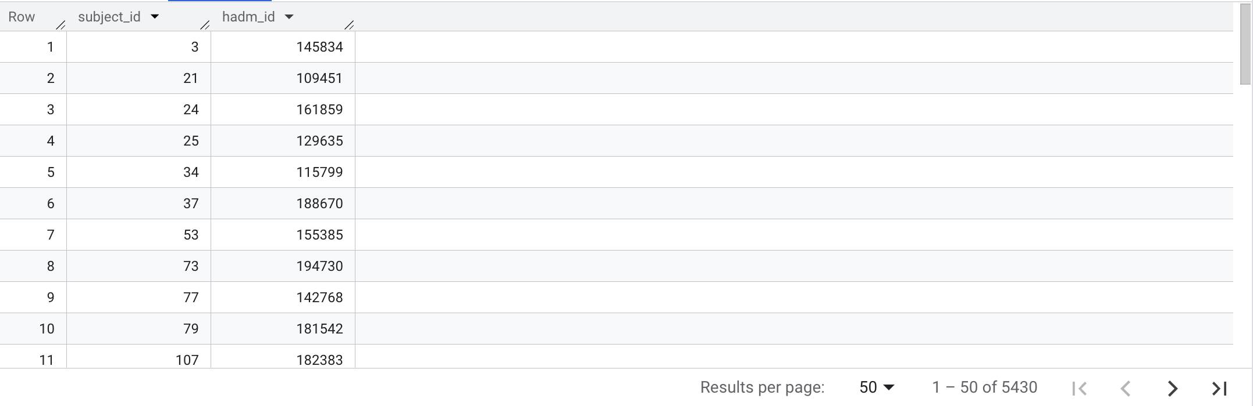
Query 1 Result

Slide 7
02. Average Age at First Admission
Data used : admissions, patients, diagnoses_icd
Description and interpretation
This query identifies each patient’s first AMI admission and calculates their age at that time.
It then computes the average age separately for each gender.
Shows if there is any gender specific trends when patients are first admitted for a heart attack. The data shows females tend to have their first heart attack later than the male patients.

Slide 8
Query 2 Statement
WITH first_ami_admission AS (
SELECT a.subject_id, a.hadm_id, a.admittime, p.gender, p.dob, ROW_NUMBER() OVER (
PARTITION BY a.subject_id
ORDER BY a.admittime ASC, a.hadm_id ASC
) AS rn
FROM `physionet-data.mimiciii_clinical.admissions` a
JOIN `physionet-data.mimiciii_clinical.patients` p
USING (subject_id)
JOIN `physionet-data.mimiciii_clinical.diagnoses_icd` d
USING (hadm_id)
WHERE d.icd9_code LIKE '410%' AND a.admittime IS NOT NULL
)
SELECT gender,
ROUND(AVG(DATE_DIFF(DATE(admittime), DATE(dob), YEAR)), 2) AS avg_age_at_first_ami
FROM first_ami_admission
WHERE rn = 1 AND DATE_DIFF(DATE(admittime), DATE(dob), YEAR) < 120
GROUP BY gender;

Slide 9
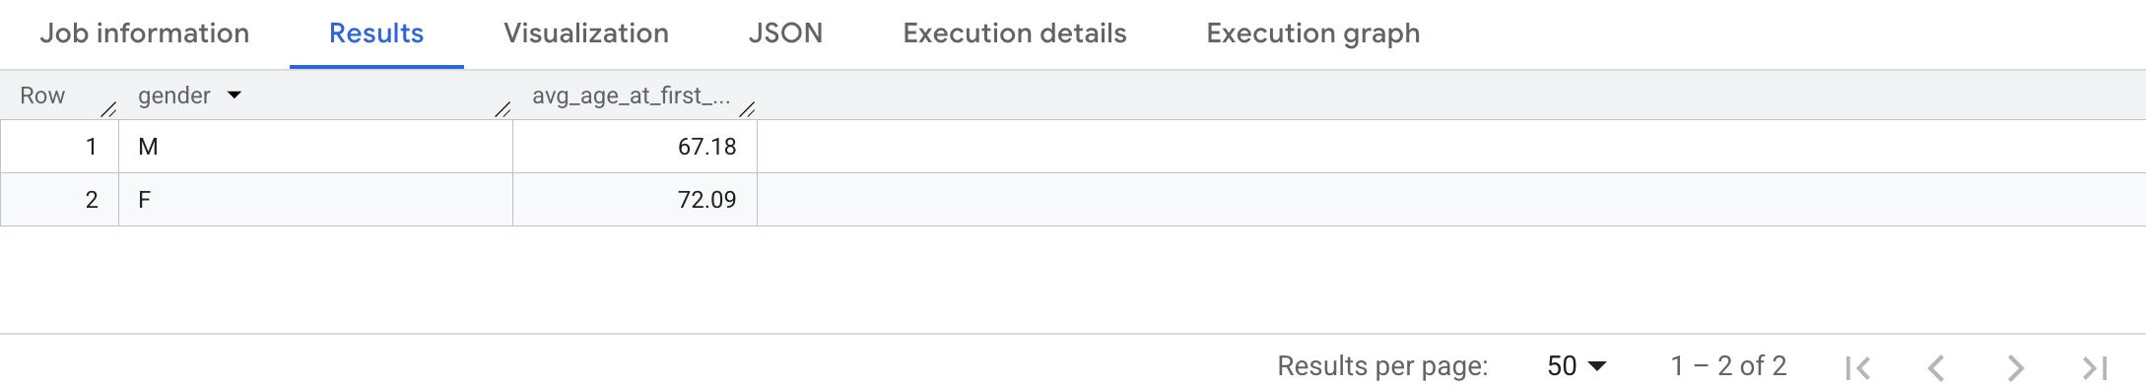
Query 2 Result

Slide 10
03. Insurance Distribution
Data used :admissions, diagnoses_icd
Description and interpretation
This query groups AMI admissions by insurance type and counts how many admissions fall under each category.
Shows which insurance types are most common among heart attack patients.

Slide 11
Query 3 Statement
SELECT
UPPER(TRIM(a.insurance)) AS insurance_type,
COUNT(DISTINCT a.hadm_id) AS admission_count
FROM `physionet-data.mimiciii_clinical.admissions` a
JOIN `physionet-data.mimiciii_clinical.diagnoses_icd` d
USING (hadm_id)
WHERE d.icd9_code LIKE '410%'
GROUP BY insurance_type
ORDER BY admission_count DESC;

Slide 12
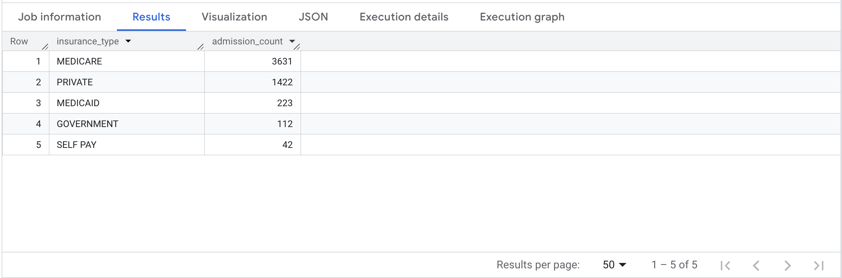
Query 3 Result

Slide 13
04. Length of Stay (LOS) Statistics
Data used :admissions, diagnoses_icd, patients
Description and interpretation
This query calculates the average, minimum, and maximum hospital stay (in days) for AMI patients’ admissions, grouped by gender.
Shows if there is any gender specific trends during hospital stays for heart attack patients.
The data shows on average, females need to stay slightly more time in hospital before they are discharged.

Slide 14
Query 4 Statement
SELECT p.gender,
ROUND(AVG(los_days), 2) AS avg_los_days,
MIN(los_days) AS min_los_days,
MAX(los_days) AS max_los_days
FROM (
SELECT a.hadm_id, a.subject_id,
DATETIME_DIFF(a.dischtime, a.admittime, DAY) AS los_days
FROM `physionet-data.mimiciii_clinical.admissions` a
JOIN `physionet-data.mimiciii_clinical.diagnoses_icd` d
ON a.hadm_id = d.hadm_id
WHERE d.icd9_code LIKE '410%'
AND a.dischtime IS NOT NULL
AND a.admittime IS NOT NULL
) sub
JOIN `physionet-data.mimiciii_clinical.patients` p
ON sub.subject_id = p.subject_id
GROUP BY p.gender
ORDER BY avg_los_days DESC;

Slide 15
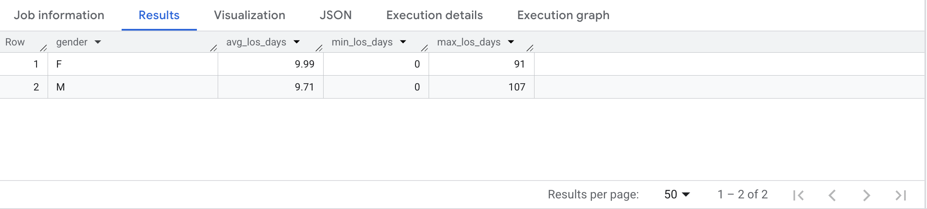
Query 4 Result

Slide 16
05. ICU Utilization by Age Group
Data used : admissions, diagnoses_icd, icustays, patients
Description and interpretation
This query groups AMI patients into age categories and calculates: Total AMI admissions, Number of ICU admissions and Percentage requiring ICU care
Checks if there is any age specific trends for AMI patients needing ICU care such as whether older heart attack patients more likely to need ICU care or not.
The results show almost every AMI patient, regardless of their age, needs ICU care.

Slide 17
Query 5 Statement
WITH ami_with_age AS (
SELECT
a.hadm_id, a.subject_id,
DATE_DIFF(DATE(a.admittime), DATE(p.dob), YEAR) AS age_at_admission
FROM `physionet-data.mimiciii_clinical.admissions` a
JOIN `physionet-data.mimiciii_clinical.diagnoses_icd` d
ON a.hadm_id = d.hadm_id
JOIN `physionet-data.mimiciii_clinical.patients` p
ON a.subject_id = p.subject_id
WHERE d.icd9_code LIKE '410%'
AND a.admittime IS NOT NULL
AND DATE_DIFF(DATE(a.admittime), DATE(p.dob), YEAR) < 120
)

Slide 18
Query 5 Statement…continued
SELECT
CASE
WHEN age_at_admission < 40 THEN '<40'
WHEN age_at_admission BETWEEN 40 AND 49 THEN '40-49'
WHEN age_at_admission BETWEEN 50 AND 59 THEN '50-59'
WHEN age_at_admission BETWEEN 60 AND 69 THEN '60-69'
WHEN age_at_admission BETWEEN 70 AND 79 THEN '70-79'
ELSE '80+'
END AS age_group,
COUNT(DISTINCT a.hadm_id) AS total_ami_admissions,
COUNT(DISTINCT i.hadm_id) AS icu_admissions,
ROUND(COUNT(DISTINCT i.hadm_id) * 100.0 / COUNT(DISTINCT a.hadm_id), 2) AS icu_utilization_pct
FROM ami_with_age a
LEFT JOIN `physionet-data.mimiciii_clinical.icustays` i
ON a.hadm_id = i.hadm_id
GROUP BY age_group
ORDER BY icu_admissions desc;

Slide 19
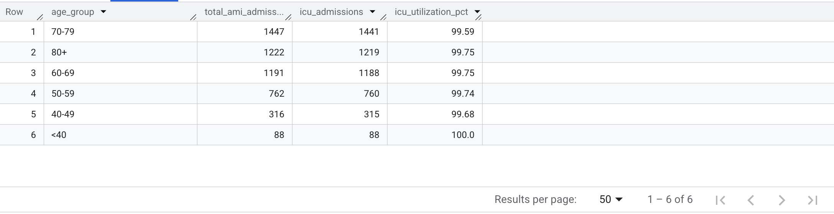
Query 5 Result

Slide 20
06. In-Hospital Mortality
Data used : admissions, diagnoses_icd
Description and interpretation
This query checks how many heart attack patients survive their hospital stay when they are admitted.
The results show that majority of the heart attack patients survive during the hospital stay.

Slide 21
Query 6 Statement
SELECT
CASE
WHEN hospital_expire_flag = 1 THEN 'Expired'
ELSE 'Survived'
END AS outcome,
COUNT(*) AS admission_count
FROM `physionet-data.mimiciii_clinical.admissions` a
JOIN `physionet-data.mimiciii_clinical.diagnoses_icd` d
USING (hadm_id)
WHERE d.icd9_code LIKE '410%'
GROUP BY outcome
ORDER BY admission_count DESC;

Slide 22
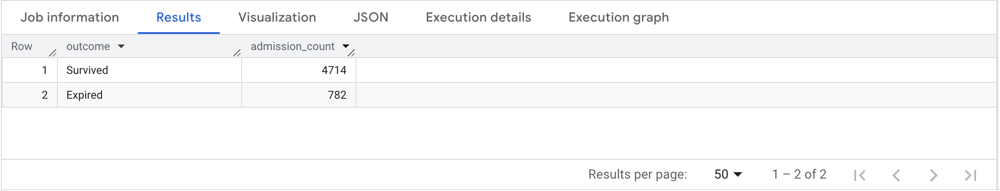
Query 6 Result

Slide 23
07. Top Cardiac Medications
Data used : prescriptions, diagnoses_icd
Description and interpretation
This query identifies the 10 most frequently prescribed medications during AMI admissions.
This data could be used for stocking inventory in hospital.

Slide 24
Query 7 Statement
SELECT
p.drug,
COUNT(*) AS prescription_count
FROM `physionet-data.mimiciii_clinical.prescriptions` p
JOIN `physionet-data.mimiciii_clinical.diagnoses_icd` d
USING (hadm_id)
WHERE d.icd9_code LIKE '410%'
GROUP BY p.drug
ORDER BY prescription_count DESC
LIMIT 10;

Slide 25
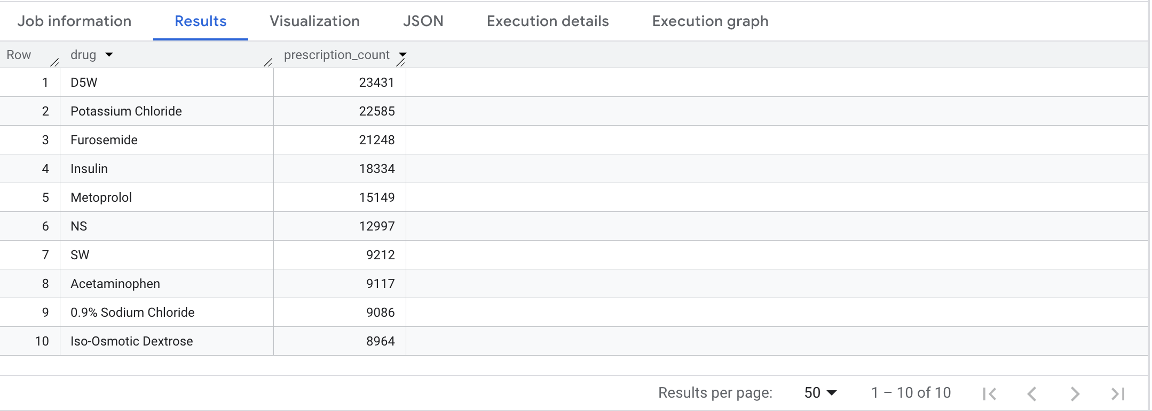
Query 7 Result

Slide 26
08. Top 10 Most Frequently Ordered Lab Tests
Data used : labevents, d_labitems, diagnoses_icd
Description and interpretation
This query identifies the most commonly ordered lab tests for heart attack patients.

Slide 27
Query 8 Statement
SELECT
di.label AS lab_test_name,
COUNT(*) AS total_orders
FROM `physionet-data.mimiciii_clinical.labevents` l
JOIN `physionet-data.mimiciii_clinical.d_labitems` di
ON l.itemid = di.itemid
JOIN `physionet-data.mimiciii_clinical.diagnoses_icd` d
ON l.hadm_id = d.hadm_id
WHERE d.icd9_code LIKE '410%'
AND l.valuenum IS NOT NULL
GROUP BY di.label
ORDER BY total_orders DESC
LIMIT 10;

Slide 28
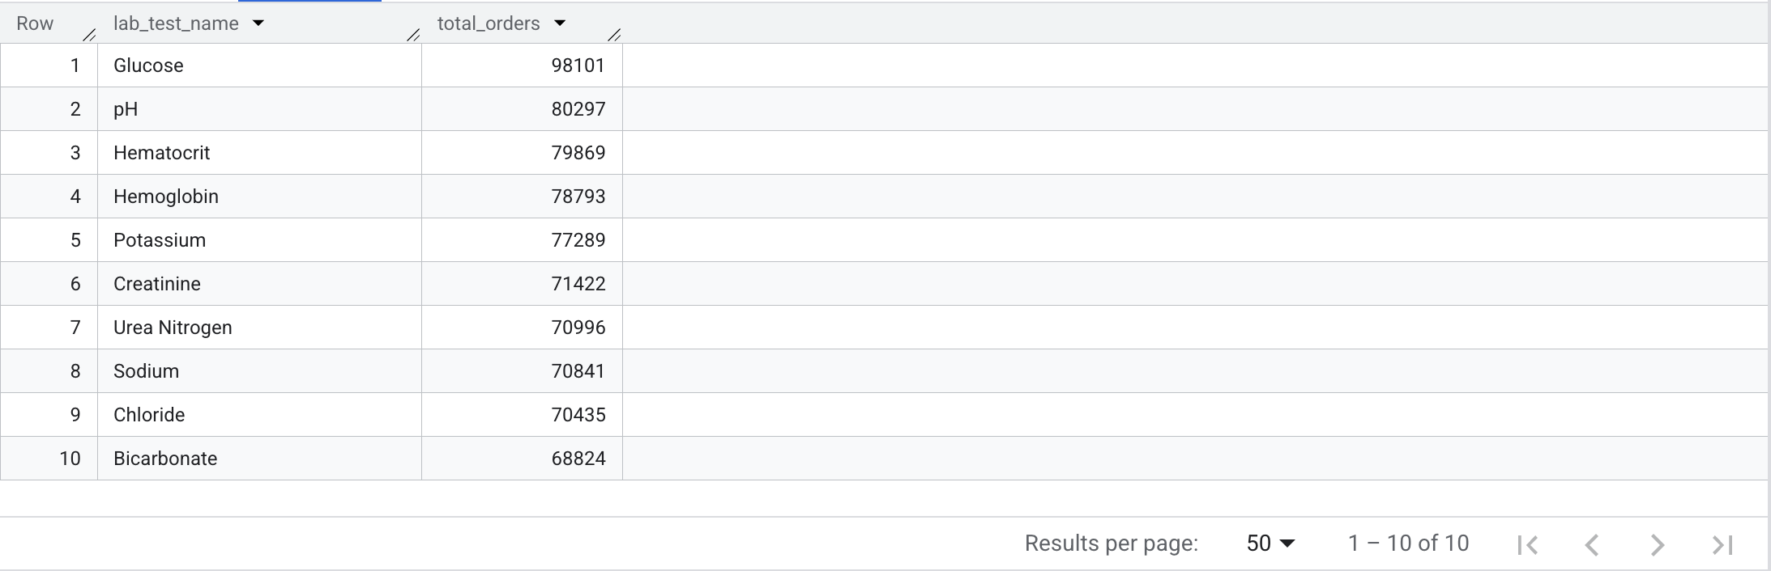
Query 8 Result

Slide 29
09. Patient Level Readmission Data
Data used : admissions, diagnoses_icd
Description and interpretation
This query analyzes readmissions among AMI patients within 30 days of their previous heart attack admission.
For that latest admission, the query calculates the number of days between the current admission and the previous one. If the interval is 30 days or less, the admission is flagged as a 30-day readmission ('Y'); otherwise, it is labeled 'N'.
It first orders all AMI admissions chronologically for each patient and uses the LAG() window function to retrieve the immediately preceding AMI admission date. Then, using ROW_NUMBER(), it isolates each patient’s most recent AMI admission.

Slide 30
Query 9 Statement
WITH admissions_with_lag AS (
SELECT a.subject_id, a.hadm_id, a.admittime, LAG(a.admittime) OVER (
PARTITION BY a.subject_id
ORDER BY a.admittime, a.hadm_id
) AS previous_admission
FROM `physionet-data.mimiciii_clinical.admissions` a
JOIN `physionet-data.mimiciii_clinical.diagnoses_icd` d
ON a.hadm_id = d.hadm_id
WHERE d.icd9_code LIKE '410%'
),
latest_admission_per_patient AS (
SELECT *, ROW_NUMBER() OVER (
PARTITION BY subject_id
ORDER BY admittime DESC, hadm_id DESC
) AS rn
FROM admissions_with_lag
)

Slide 31
Query 9 Statement..continued
SELECT subject_id, hadm_id AS latest_hadm_id,
admittime AS latest_admission, previous_admission,
DATE_DIFF(DATE(admittime), DATE(previous_admission), DAY) AS days_between_admissions,
CASE
WHEN DATE_DIFF(DATE(admittime), DATE(previous_admission), DAY) <= 30
THEN 'Y'
ELSE 'N'
END AS readmitted_within_30d
FROM latest_admission_per_patient
WHERE rn = 1 AND previous_admission IS NOT NULL
ORDER BY days_between_admissions ASC, latest_hadm_id DESC, subject_id ASC;

Slide 32
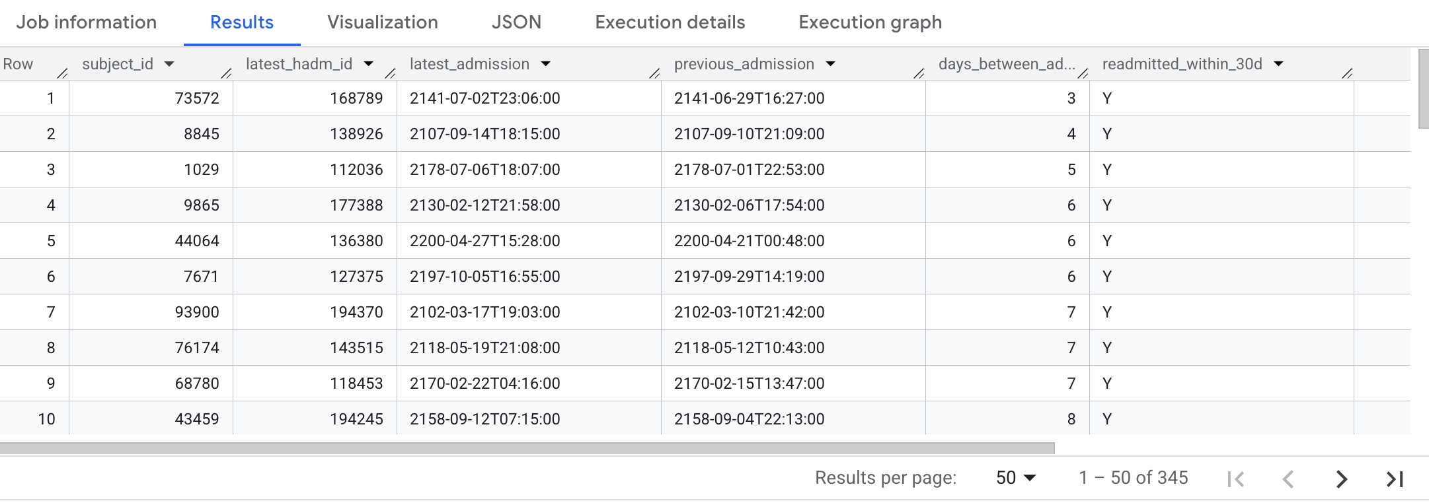
Query 9 Result

Slide 33
10. Overall 30-Day Readmission Rate
Data used : admissions, diagnoses_icd
Description and interpretation
This query calculates the overall 30-day readmission rate among hospitalized AMI patients.
First, it orders all AMI admissions chronologically for each patient and uses the LAG() window function to identify the immediately preceding admission date.
For every admission that has a prior hospitalization, it computes the number of days between the two admissions.
Then it determines whether the interval between admissions is 30 days or fewer.
The query then calculates the overall readmission rate as a percentage.

Slide 34
Query 10 Statement
WITH readmissions AS (
SELECT a.subject_id, LAG(a.admittime) OVER (
PARTITION BY a.subject_id
ORDER BY a.admittime
) AS prev_admit,
a.admittime
FROM `physionet-data.mimiciii_clinical.admissions` a
JOIN `physionet-data.mimiciii_clinical.diagnoses_icd` d
ON a.hadm_id = d.hadm_id
WHERE d.icd9_code LIKE '410%'
)
SELECT ROUND(AVG(CASE WHEN DATE_DIFF(DATE(admittime), DATE(prev_admit), DAY) <= 30
THEN 1 ELSE 0
END
) * 100, 2
) AS readmission_rate_pct
FROM readmissions
WHERE prev_admit IS NOT NULL;

Slide 35
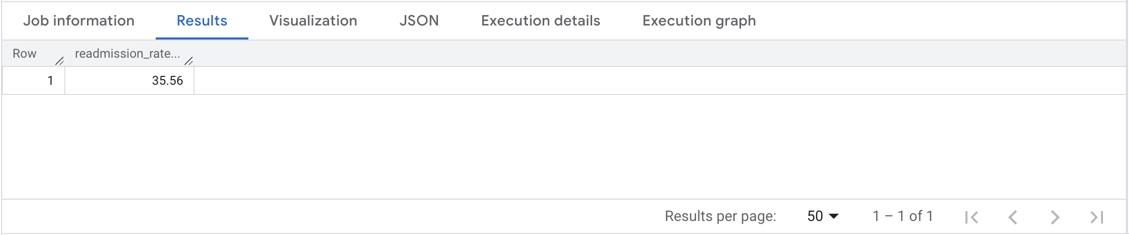
Query 10 Result

